Slide 1


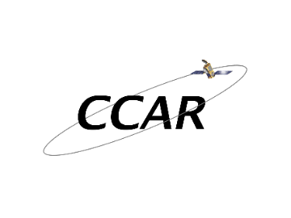
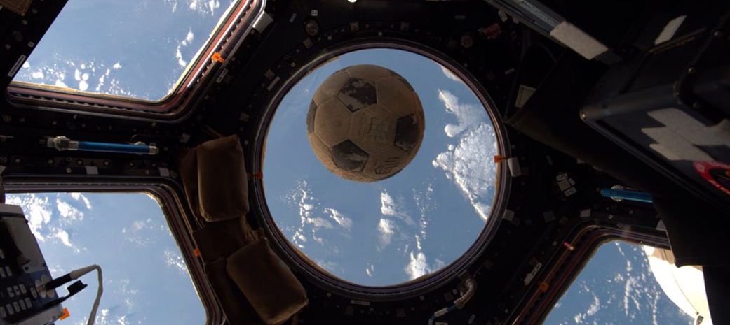
Investigating the physical mechanisms that establish electric fields in the atmosphere
Thesis Defense for Greg Lucas
Advisor:
Jeffrey Thayer
Committee:
Jeffrey Forbes
Robert Marshall
Katja Friedrich
Wiebke Deierling

Slide 2
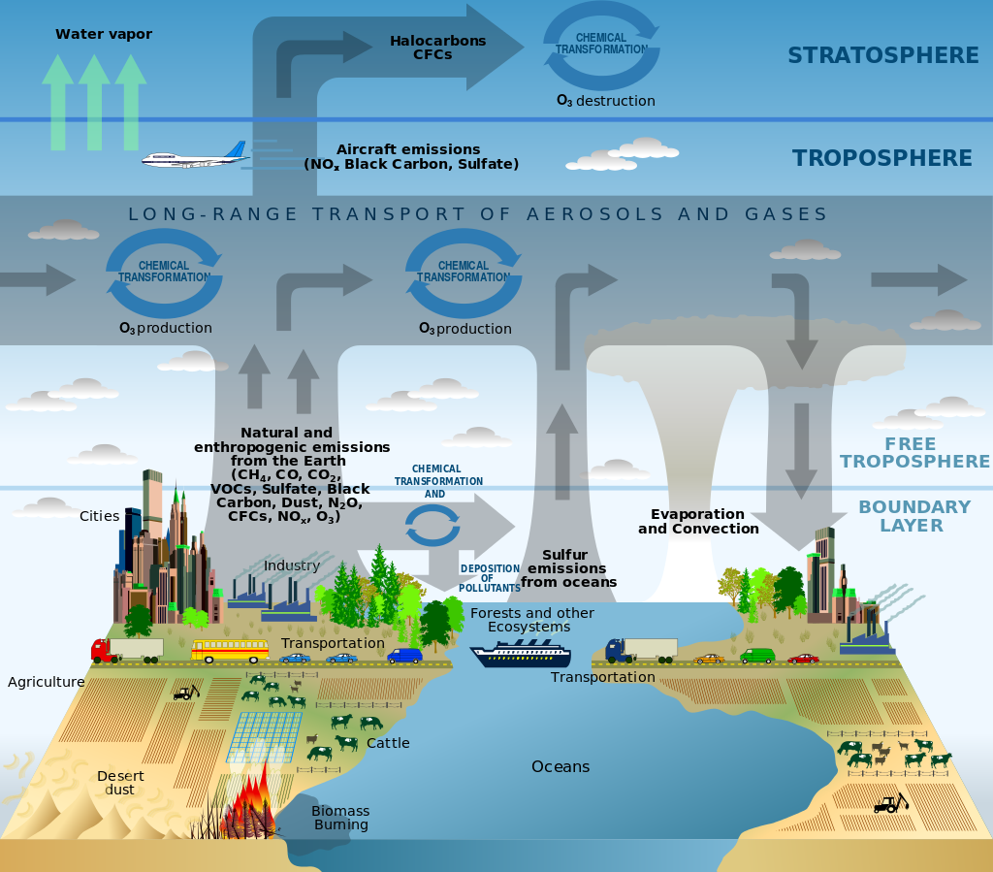
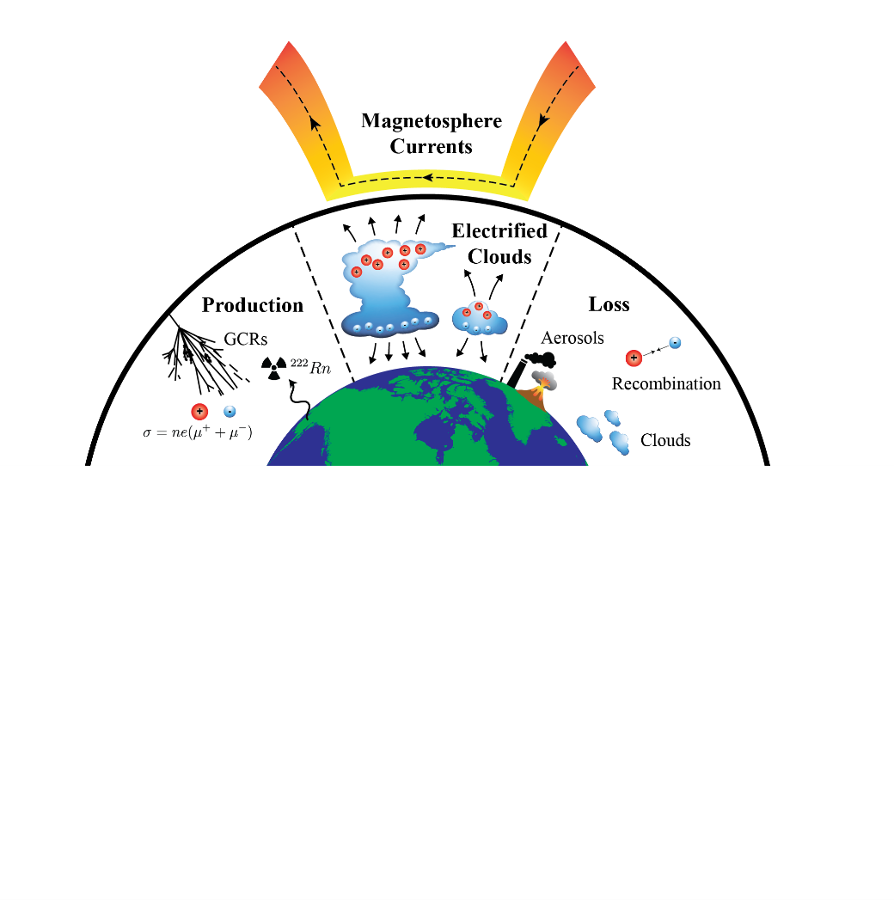
What is in a climate model?
Dynamics
Radiation
Chemistry
Electrical?
US Climate Change Technology Strategic Plan

Slide 3
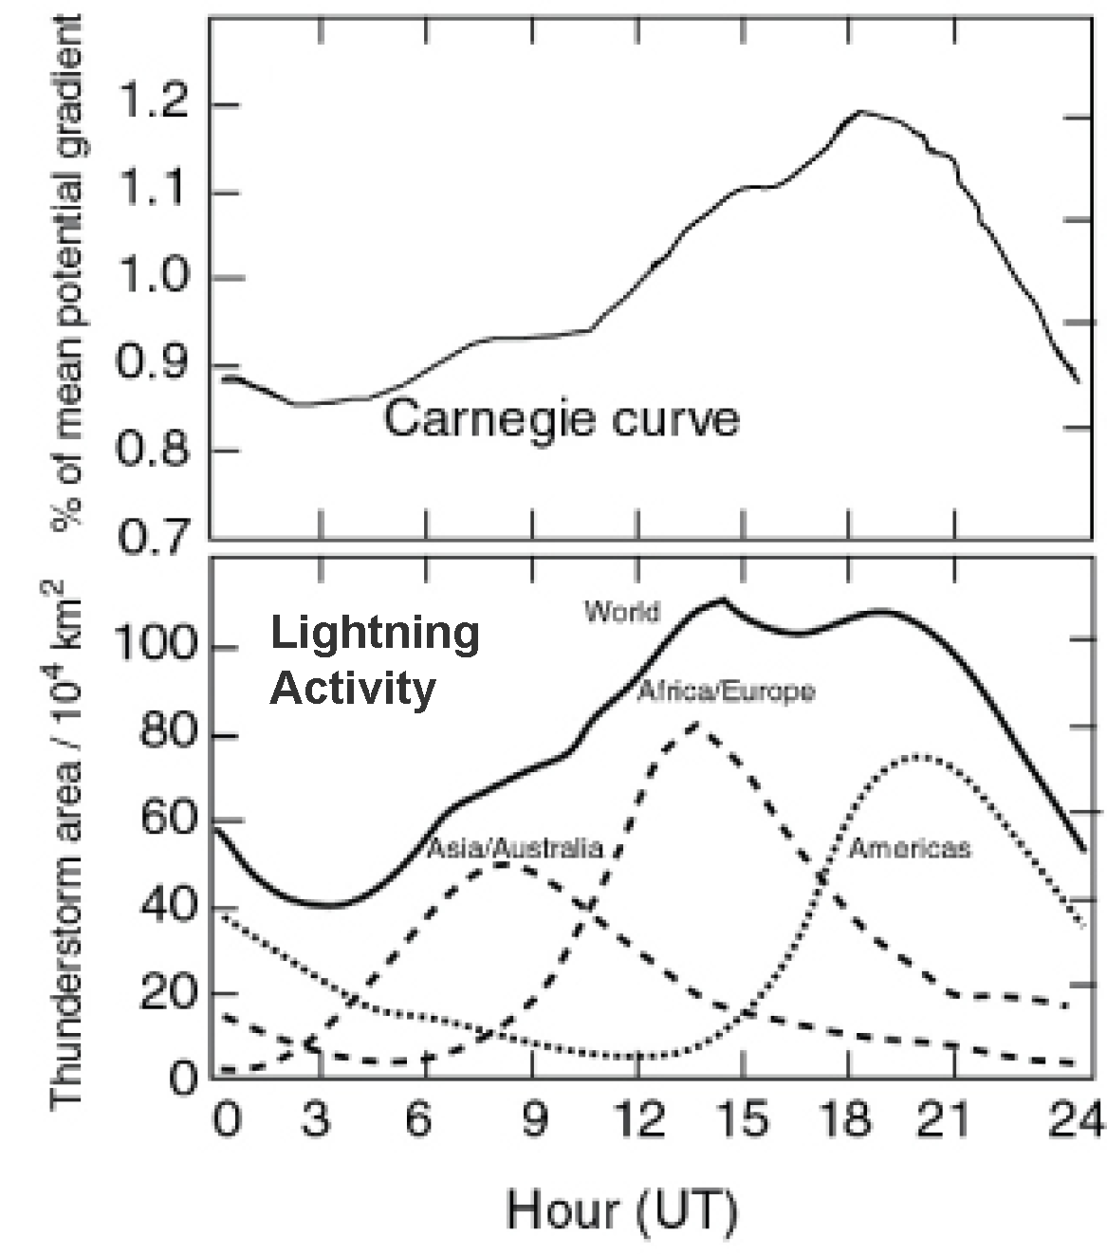
Electric fields have been measured for over a century
Typically think of lightning flashes and very short duration events, but there is also a small background electric field present throughout the atmosphere
This background field is correlated with the global thunderstorm distribution
Whipple & Scrase 1936

Slide 4
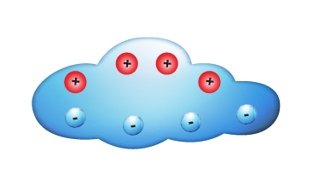
Electric forces are small, but may play a large role in microphysical processes
Are cloud heights modified by the electric field?
Are cloud growth processes different in an external field?
Ionosphere
+ + + + + + + +
- - - - - - - -
Ground
Harrison et al. 2015

Slide 5
How do physical ion production and loss mechanisms affect electric fields in the atmosphere on both global and local scales?

Slide 6
How do physical ion production and loss mechanisms affect electric fields in the atmosphere on both global and local scales?
What impact do local meteorological processes have on the measurement of atmospheric electric fields?
How does the global conductivity and source distribution influence local atmospheric electric field measurements?
How does the magnetospheric current system influence atmospheric electric fields in the global electric circuit?
What impact do strong conductivity perturbations have on the global electric circuit?

Slide 7
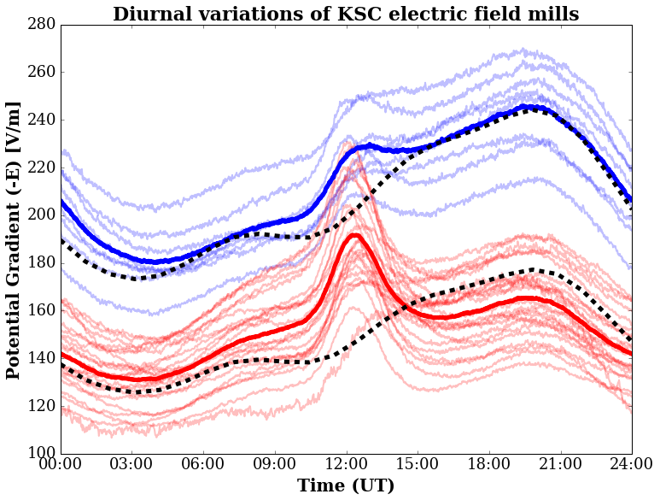
What impact do local meteorological processes have on the measurement of atmospheric electric fields?
31 field mills located in the same region, but producing different electric fields

Slide 8
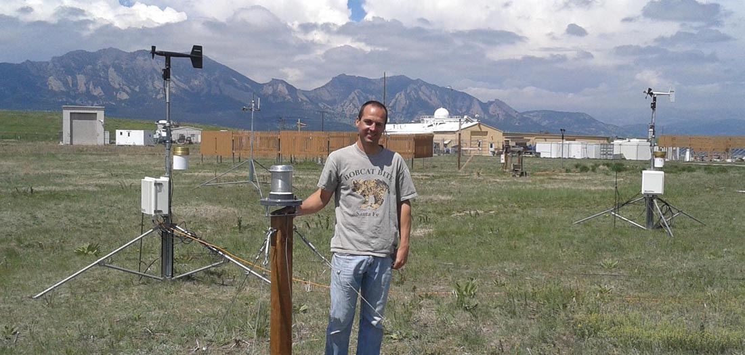
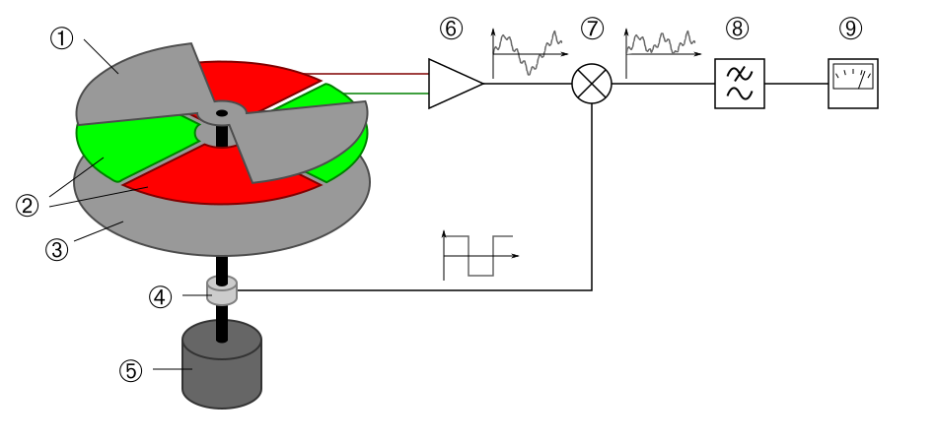
Electric field mills are used to measure atmospheric electric fields
A spinning rotor alternately shields/exposes a sense plate
Installation of an electric field mill
E

Slide 9
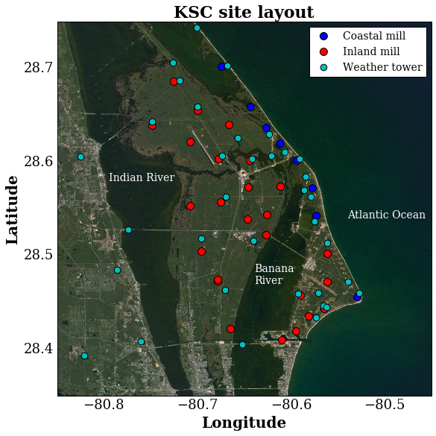
A statistical analysis of 18-years worth of data from an array of field mills
First in-depth analysis of the fair-weather measurements from KSC
Analyze spatial relationships with the distributed array of field mills
Investigate statistical trends within the data rather than looking at case studies

Slide 10
K-means clustering algorithm identified two distinct groups of field mills
- Coastal
- Inland

Slide 11
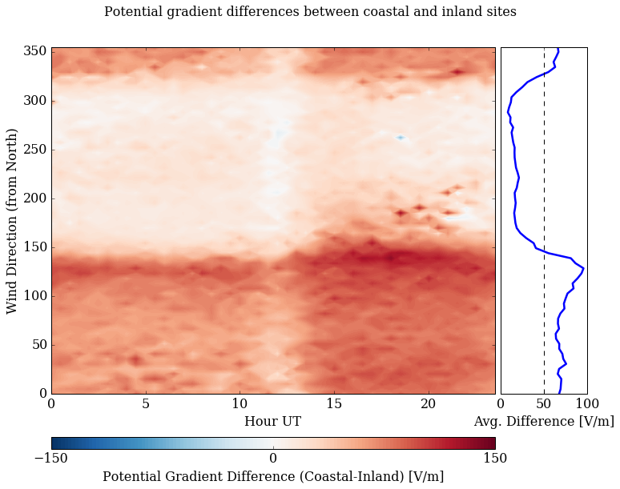
Wind direction creates a difference between coastal and inland mills
Southwest wind: Minimal differences
Northeast wind: >50 V/m differences
Wind data from local weather towers

Slide 12
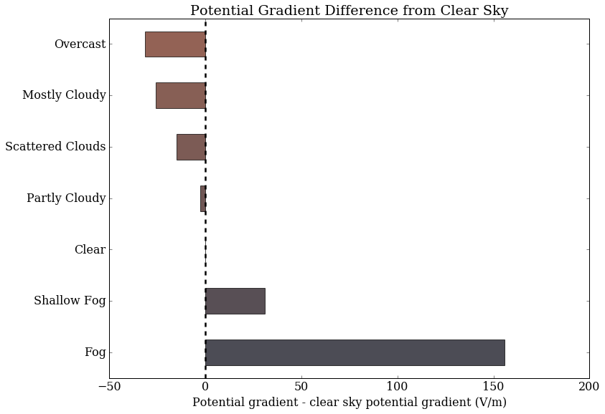
Clouds act like resistors, modifying the local electric fields
Conductivity is known to be reduced within clouds
The magnitude of the reduction is speculated to be more than 1/10 in other models
Rather than looking at individual clouds, we look at the statistical occurrence of clouds and electric fields over 18 years worth of data
Cloud cover obtained from METARs

Slide 13

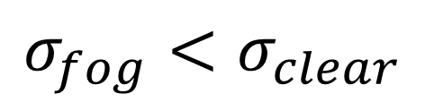

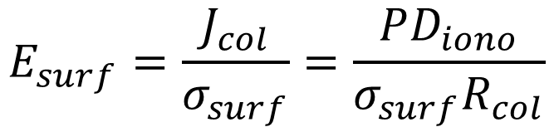
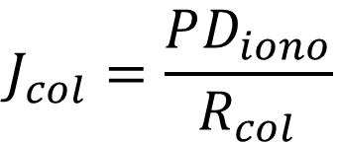
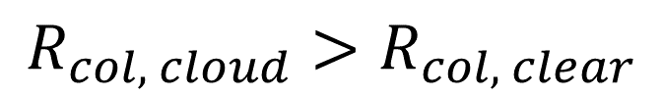
Clouds act like resistors, modifying the local electric fields
$$J_{col}=\frac{PD_{iono}}{R_{col}}$$
Constant current density in the column
$$R_{col, cloud}>R_{col, clear}$$
$$E_{surf}=\frac{J_{col}}{σ_{surf}}=\frac{PD_{iono}}{{σ_{surf}R}_{col}}$$
Overhead clouds: ↑ $R_{col}$ ↓ $E_{surf}$
$$σ_{fog}<σ_{clear}$$
Local fog: ↓ $σ_{local}$ ↑ $E_{surf}$
Cloud cover obtained from METARs

Slide 14
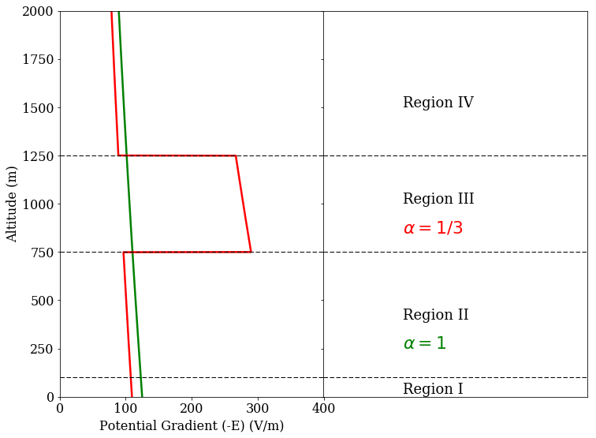
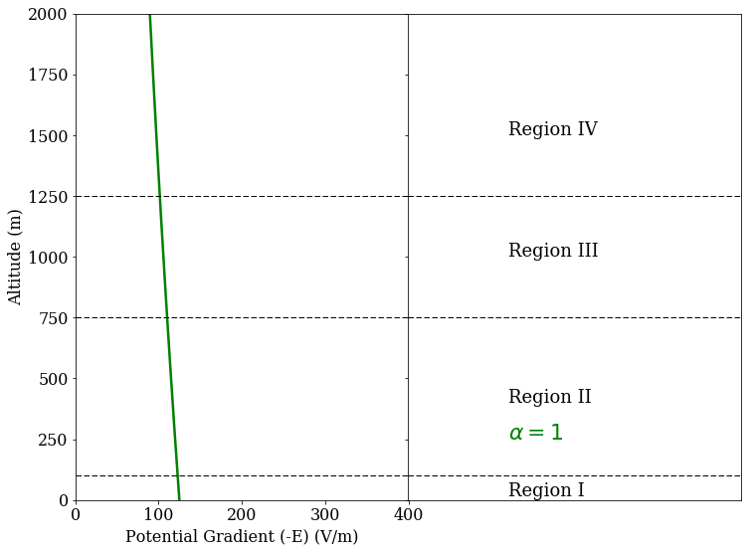
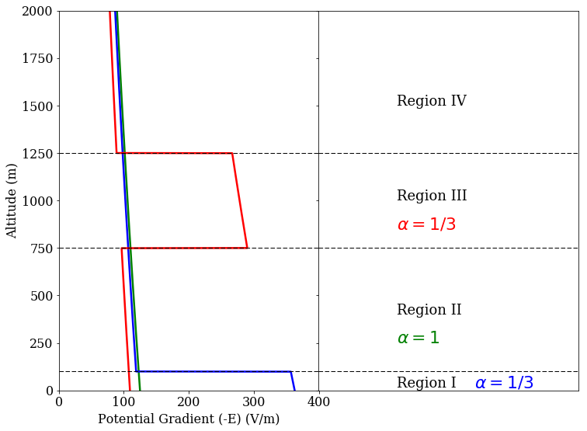
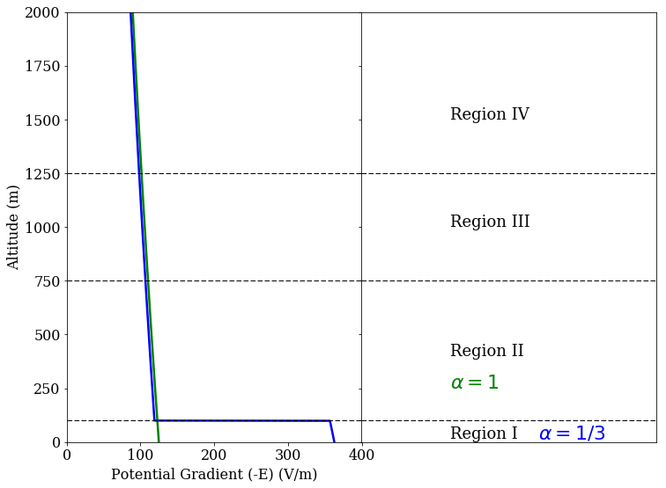
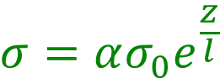
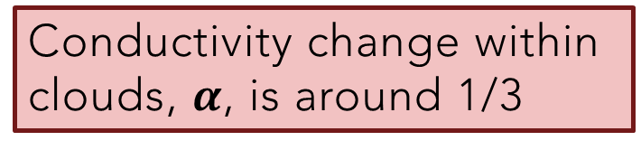
Clouds act like resistors, modifying the local electric fields
$$J_{col}=\frac{PD_{iono}}{R_{col}}$$
Constant current density in the column
$$σ={ασ_{0}e}^{\frac{z}{l}}$$
$$E_{surf}=\frac{J_{col}}{σ_{surf}}=\frac{PD_{iono}}{{σ_{surf}R}_{col}}$$
Overhead clouds: ↑ $R_{col}$ ↓ $E_{surf}$
Local fog: ↓ $σ_{local}$ ↑ $E_{surf}$
Conductivity change within clouds, $α$, is around 1/3

Slide 15
What impact do local meteorological processes have on the measurement of atmospheric electric fields?
Distributed array of field mills shows spatial dependencies of inland and coastal sites to the local wind direction
Statistical nature of the dataset puts a limit on the conductivity change within clouds
Winds from the ocean create a 50 V/m enhancement in the coastal mills
METARs observation of cloud cover show a conductivity change of ~1/3
Lucas et al. 2017

Slide 16
How does the global conductivity and source distribution influence local atmospheric electric field measurements?
Although the magnitudes are different, there is still a similar trend for all mills produced by the global electric circuit

Slide 17
Previous GEC models make many limiting assumptions to obtain a solution
Hays and Roble 1979
Tinsley and Zhou 2006
Parameterization of conductivity
3 regions with analytic solutions
Parameterization of ion production and losses
No incorporation of source currents

Slide 18
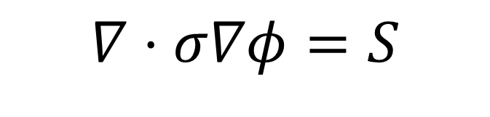
WACCM-GEC is the first self-consistent physics-based GEC model
Incorporate an electrical system into a community climate model CESM(WACCM)
Current continuity maintained throughout the atmosphere
$$∇⋅σ∇φ=S$$

Slide 19
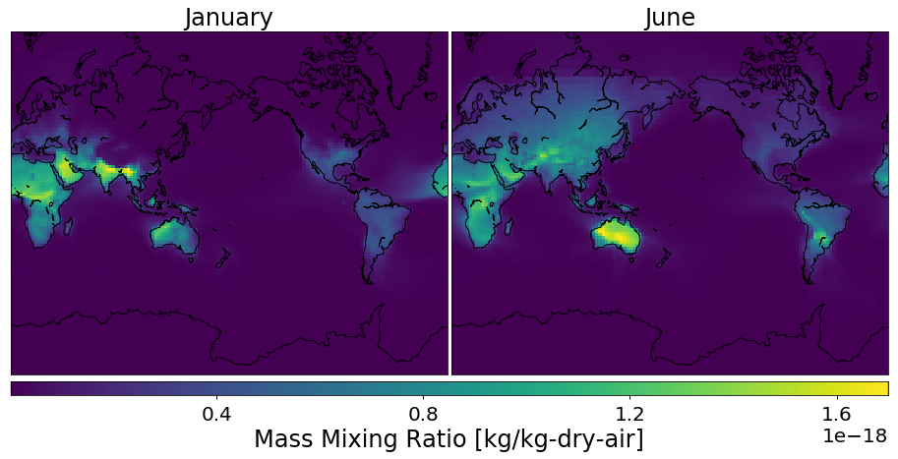
Production and loss of the ions are handled self-consistently in the model
Radon is only released from ice-free land surfaces
Radon is advected within the model (this is why there is radon over the oceans)

Slide 20
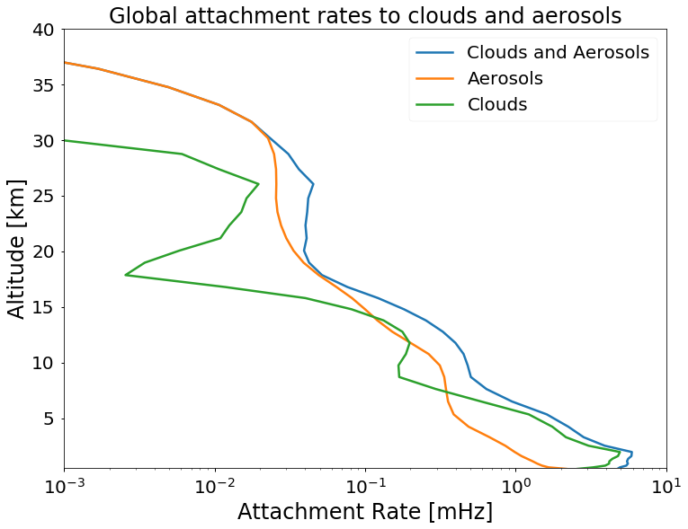
Production and loss of the ions are handled self-consistently in the model
Attachment to clouds utilizes 2-moment microphysics
Physically representative, rather than conductivity reduction factors
4-mode aerosol module is used to produce aerosols in the model (includes biomass and volcanoes)
Clouds are the dominant source of attachment below 10 km

Slide 21
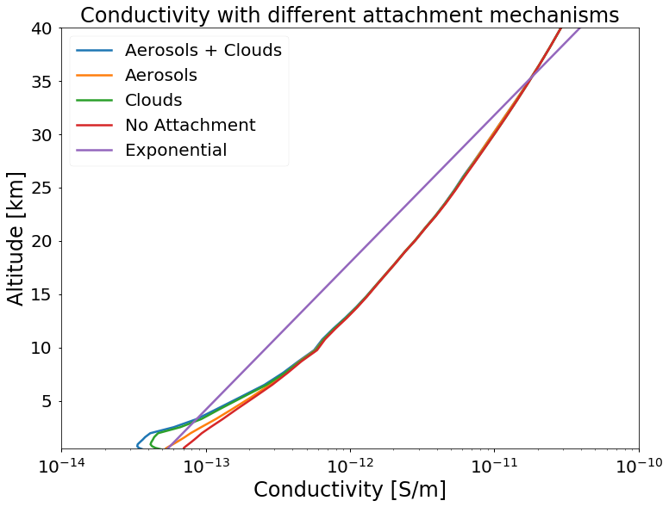
Realistic conductivity profiles are created with WACCM-GEC
Model production includes: GCRs, radon, solar energetic particles
Model losses include: Clouds, aerosols, recombination
Incorporation of all these processes causes significant deviations from analytic expressions

Slide 22
Physical representation of ion production and loss mechanisms implemented



Slide 23
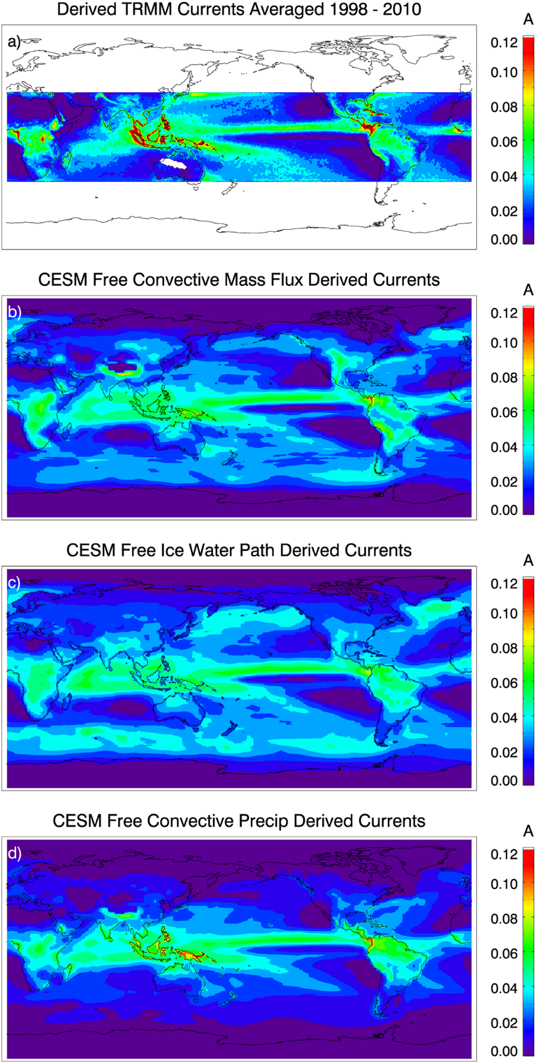
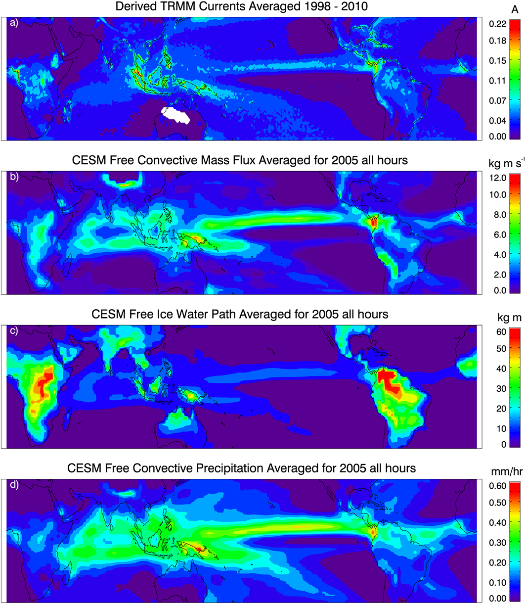
Convective precipitation rate of storms dictates the strength of currents
Previous work has shown that convective precipitation rate has good skill when predicting currents
$$I_{GEC}=f(Convective Precipitation Rate)$$
Satellite + Aircraft observations
Kalb et al. 2016

Slide 24
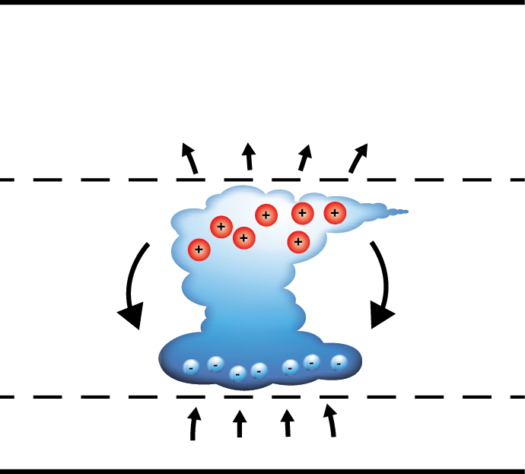

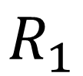
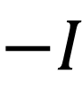
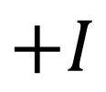
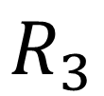

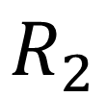
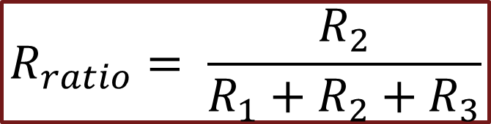
Electrified clouds act as a current source
$$I_{GEC}$$
Internal resistance of the dipole current source is important for global current production
Efficiency factor for producing a global current:
Ionosphere
$$R_{3}$$
$$I_{GEC}=I∗R_{ratio}$$
-35 C
$$+I$$
$$R_{2}$$
$$R_{ratio}= \frac{R_{2}}{R_{1}+R_{2}+R_{3}}$$
$$−I$$
$$R_{1}$$
-5 C
Ground

Slide 25
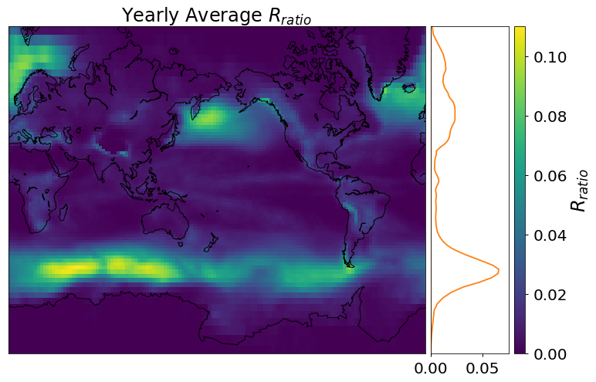
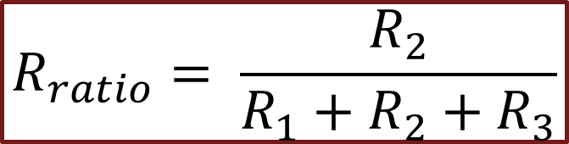
Storms are more efficient at higher latitudes
Internal resistance has never been accounted for in other global models
3D storm location is determined by temperature (-35 < T < -5) and updraft
$$R_{ratio}= \frac{R_{2}}{R_{1}+R_{2}+R_{3}}$$

Slide 26
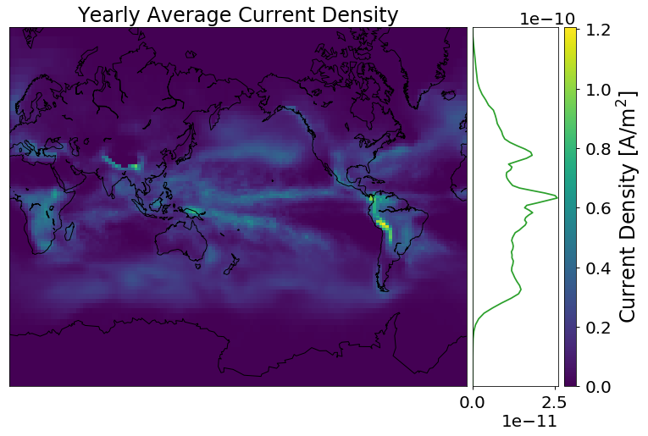
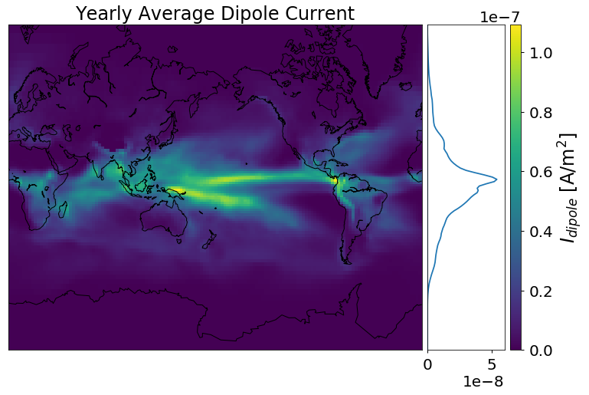
The global current from a storm is a combination of strength and efficiency
$$I_{GEC}=R_{ratio}∗f(Convective Precipitation Rate)$$

Slide 27
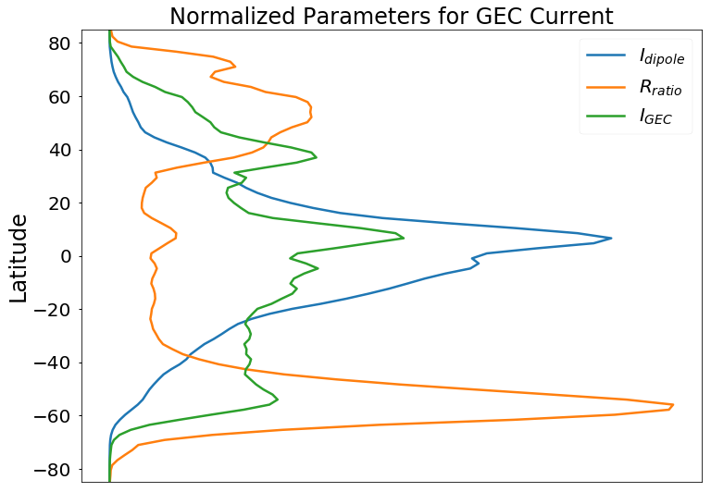
The global current from a storm is a combination of strength and efficiency
Dipole source strength is peaked near the equator
Efficiency is peaked towards the poles
Global current is smoothed towards mid-latitudes

Slide 28
Current sources are implemented with a dependence on conductivity




Slide 29
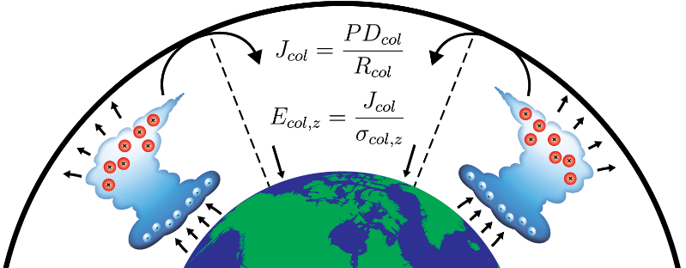
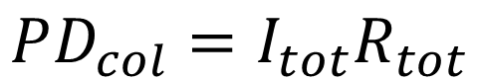
How does the global conductivity and source distribution influence local atmospheric electric field measurements?
$$PD_{col}=I_{tot}R_{tot}$$
Create an ionospheric potential difference
PD produces return currents and E-fields
Lucas et al. 2015

Slide 30
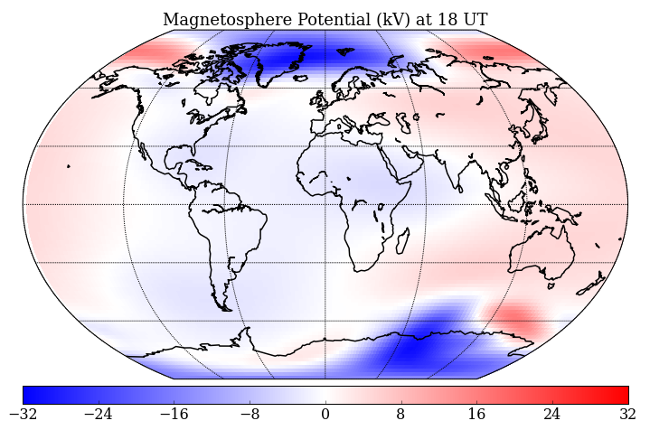
How does the magnetospheric current system influence atmospheric electric fields in the global electric circuit?




Lucas et al. 2015

Slide 31
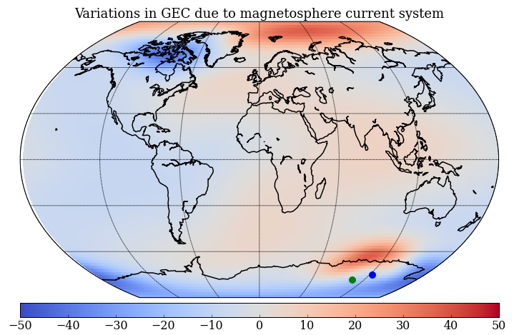
How does the magnetospheric current system influence atmospheric electric fields in the global electric circuit?
Unique phasing seen at high latitudes that agrees with measurements
Covered in comprehensive exam, so won’t go into details here
Vostok
Concordia
Lucas et al. 2015

Slide 32
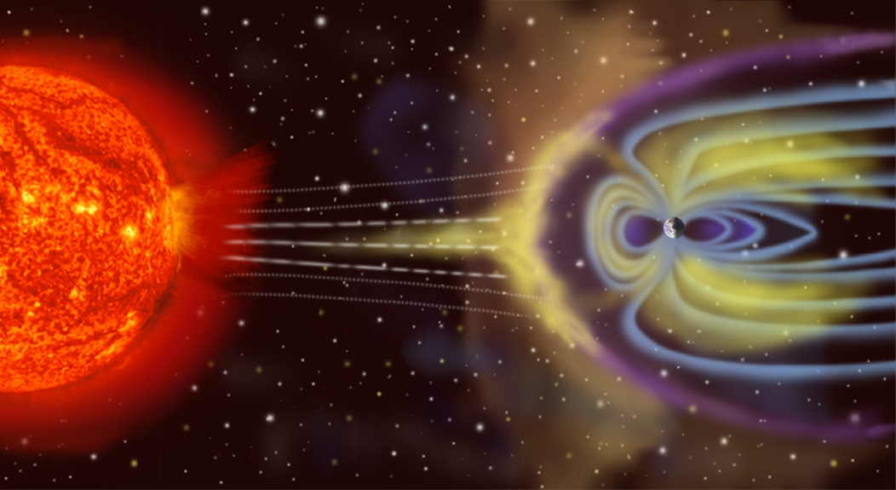
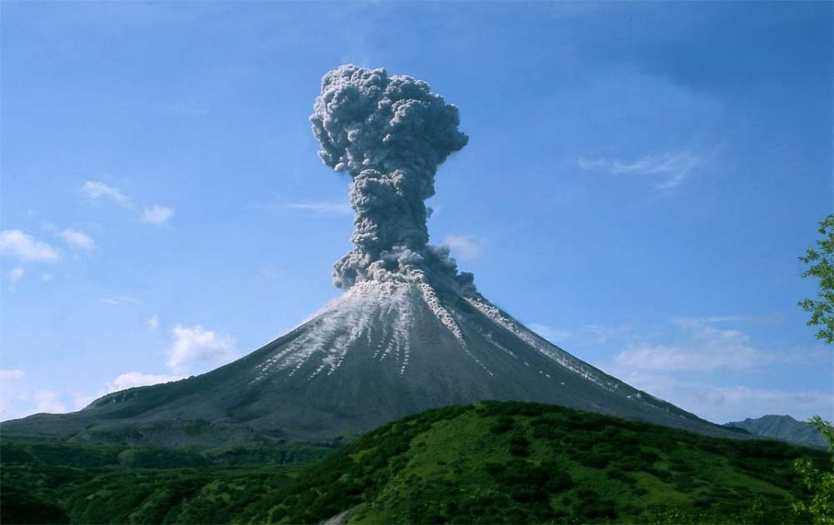
What impact do strong conductivity perturbations have on the global electric circuit?
GCR variability and volcanic eruptions modify the conductivity of the atmosphere, but by how much?
NASA Goddard
Live Science

Slide 33
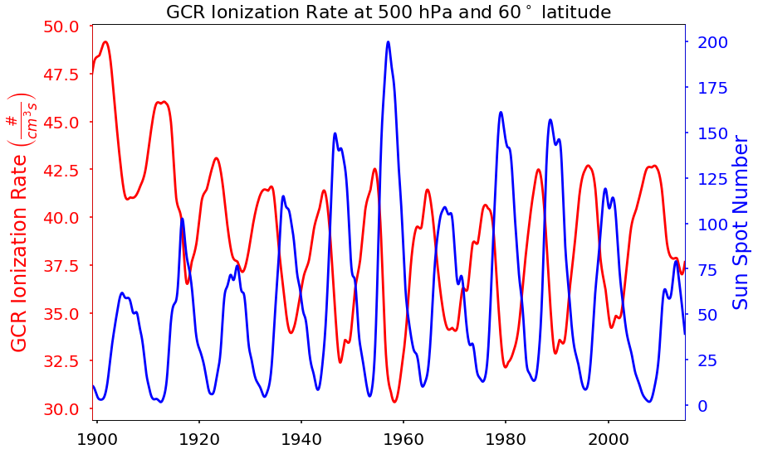
The 11-year solar cycle changes the flux of galactic cosmic rays
GCRs are anti-correlated with the solar cycle
GCR data obtained from neutron monitor counts and modeled ionization rates (CMIP6 is used)

Slide 34
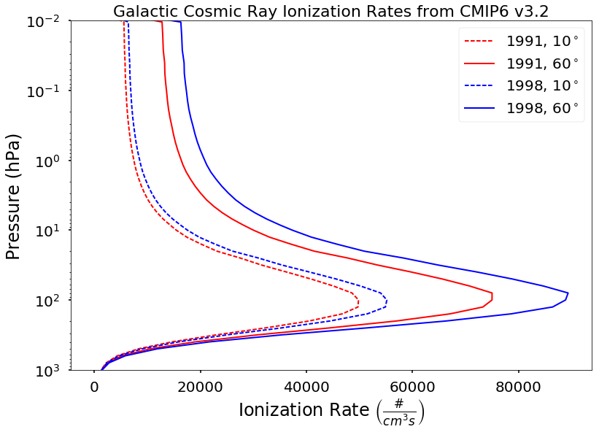
GCRs are the dominant ion production mechanism in the middle atmosphere
Solar min (GCR max) in 1998 produces more ionization than solar max (GCR min) in 1991
Differences are not as noticeable near the surface, or at lower latitudes (dashed lines)
~15 km

Slide 35
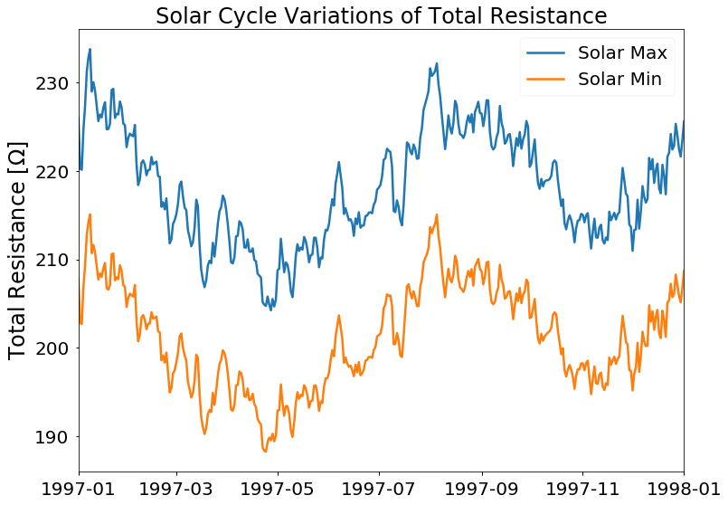
Changing ionization rates leads to a 20 Ω difference in solar max/min conditions
Model run for 1997
Only changed the GCR ionization rate from solar min to solar max (leave all other production and loss mechanisms the same)
~10% change in total resistance of the atmosphere

Slide 36
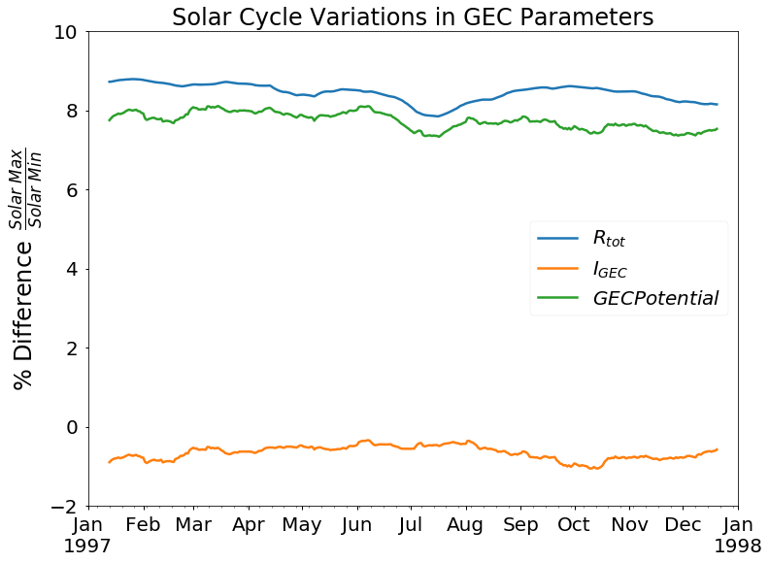
Solar cycle variations of around 10% can be seen in the GEC potential
Reduction of source strengths by 1% during solar max (GCR min)
Accounting for source and resistance changes leads to an 8% change in the GEC potential

Slide 37

The Pinatubo eruption of 1991 is the most recent major explosive volcano
Aerosols were ejected into the stratosphere and were circulated around the globe over several months
Running over the year 1991, the impact that this volcanic eruption had on the global electric circuit can be investigated
?

Slide 38

Total resistance of the atmosphere is increased from ion-aerosol attachment
Increasing the aerosol content of the atmosphere increases the ion loss rate
Pinatubo eruption has little influence on the total resistance, but a volcano 50x the size more than doubles the total resistance

Slide 39

50x Pinatubo Run
Column resistance changes over time from a 50x Pinatubo run
Volcano erupts in mid-June increasing the column resistance across the globe

Slide 40

Sources are more complicated than resistance changes alone
Volcanic aerosols feedback on the microphysical cloud and radiative properties of the atmosphere
Run with MP includes feedback mechanisms
All other runs have aerosol feedback turned off

Slide 41

Microphysical feedbacks within the climate models need to be included
Potential is increased when volcanic aerosols are included
Complicated microphysical coupling in storm creation creates unique influences that a simple electric circuit model cannot account for

Slide 42
What impact do strong conductivity perturbations have on the global electric circuit?
Solar cycle and volcanic eruptions have around a 10% influence on the GEC, unless gigantic events are considered
Microphysical feedbacks within the climate models need to be considered, not just simple equivalent circuits
Lucas et al., In preparation

Slide 43
Several major milestones were completed during the thesis
I identified the impact of local meteorology on the measurement of near-surface electric fields and emphasized the importance of spatially distributed and temporally extensive electric field observations in distinguishing global and local phenomena.
I created the most advanced 3-D, physics-based global electric circuit model which produces a complete and internally consistent description of conductivity, currents, and electric fields in the atmosphere.
I demonstrated that, with this sophisticated model, physical effects on the global electric circuit, from solar influences to cloud microphysics, can be explored for the first time.

Slide 44
Future extensions of the work
This thesis focused on building and using the GEC model for the determination of electric fields. I have not investigated how these electric fields couple back into the microphysics. Future researchers can build off of my work and implement the feedback mechanisms
WACCM-GEC is not able to resolve the features seen in the local observations, so I also created a local conductivity model within a local weather model (WRF)
The modeling work within this thesis provides a consistent way to evaluate theories related to observations of electric fields in the atmosphere

Slide 45
Papers produced during this thesis
2 first author, 4 co-authors
Baumgaertner, A. J. G., Thayer, J. P., Neely, R. R., & Lucas, G. (2013). Toward a comprehensive global electric circuit model: Atmospheric conductivity and its variability in CESM1 (WACCM) model simulations. Journal of Geophysical Research: Atmospheres, 118(16), 9221-9232
Baumgaertner, A. J. G., Lucas, G. M., Thayer, J. P., & Mallios, S. A. (2014). On the role of clouds in the fair weather part of the global electric circuit. Atmospheric Chemistry and Physics, 14(16), 8599-8610
Liu, X., Wang, W., Thayer, J. P., Burns, A., Sutton, E., Solomon, S. C., ... & Lucas, G. (2014). The winter helium bulge revisited. Geophysical Research Letters, 41(19), 6603-6609
Bayona, V., Flyer, N., Lucas, G. M., & Baumgaertner, A. J. G. (2015). A 3-D RBF-FD solver for modeling the atmospheric global electric circuit with topography (GEC-RBFFD v1. 0). Geoscientific Model Development, 8(10), 3007
Lucas, G. M., Baumgaertner, A. J. G., Thayer, J. P. (2015). A global electric circuit model within a community climate model. Journal of Geophysical Research: Atmospheres
Lucas, G. M., Thayer, J. P., Deierling, W. (2017). Statistical analysis of spatial and temporal variations in atmospheric electric fields from a regional array of field mills. Journal of Geophysical Research: Atmospheres 122(2), 1158-1174
1 first author submitted soon, 1 co-author currently under review

Slide 46
Thank you to all my family and friends!
I have accepted a two-year post-doc position at the USGS working with magnetometer data related to geomagnetic storms (switching from E to M for a little while)
Thanks to my family for all of their support
My parents for instilling in me a desire to learn
The Tuomalas for inviting me over on holidays and sporting events
My girlfriend Allison Dean for all of the fun times on all of our adventures
The Deans for so many fun family dinners
I wish to thank all my work colleagues, specifically my advisor Jeff and those listed below
Andreas Baumgaertner, Wiebke Deierling, Robert Marshall, Jeff Forbes, Katja Friedrich, Scott Palo, Art Richmond, Astrid Maute, Wenbin Wang, Victor Pasko, Jaroslav Jansky, and Mike Mills
My friends and office mates:
Mike Croteau, Dimitri Krattiger, Mack Jones, Ryan McGranaghan, Vu Nguyen, Vicki Hsu, Robert Stillwell, Rory Barton-Grimley, Nick Rainville, Tevis Nichols, and Roger Laurence III

Slide 47
Backup slides

Slide 48

Anomalous ‘bump’ in the diurnal signature is due to the sunrise enhancement
PG is largest about 1 hour after sunrise
Correlates well with both low wind speed and high relative humidity
Unable to distinguish between these two variables
Local sunrise

Slide 49

18-Year wavelet analysis shows a strong diurnal signal and weak annual signal
Wavelet analysis shows how the periodic power varies over the entire dataset
Periodic local effects can mask these signals
Over time the signal appears to be weakening
Diurnal
Annual

Slide 50


Aerosol attachment rates are more localized (Asia/Africa) compared to clouds

Slide 51


WACCM-GEC Clouds
Baumgaertner et. al 2014
Global climate models can’t resolve individual clouds
Developed a FEM simulation to model the converging and diverging currents going around clouds
Small cloud approx
Large cloud approx
Convergence/Divergence
Multiple clouds

Slide 52



WACCM-GEC Sources
Kalb et. al (in prep)
Utilize the FEM simulation to determine the total current leaving a grid cell, $I_{col}$

Slide 53
WACCM-GEC Magnetosphere
Magnetospheric currents generate cross-cap potentials at high latitudes
Need to modify the uniform upper boundary condition

Slide 54


WACCM-GEC Magnetosphere
Magnetospheric currents generate cross-cap potentials at high latitudes
Need to modify the uniform upper boundary condition
No current flow between the GEC and magnetosphere
Integrate the leakage current through each column contributed by the magnetosphere
$$PD_{float}=\int_{4π}{\frac{PD_{col}^{mag}}{R_{col}}\text{d}S ∗R_{tot}}$$

Slide 55


WACCM-GEC Phase Relationships
Magnetosphere current system rotates in geomagnetic coordinates, while GEC current system rotates in geographic coordinates
Decompose the column potential into magnetosphere and GEC contributions
Relative influence of the magnetosphere on the GEC
$$PD_{col}\left(t\right)=C_{col}$$
$+{ A}_{col}^{mag}\cos\left(ωt+φ_{col}^{mag}\right)$
$+{ A}_{GEC}\cos\left(ωt+φ_{GEC}\right)$
$$\% Change=100\frac{A_{col}^{mag}}{A_{GEC}}\cos{(φ_{col}^{mag}−φ_{GEC})}$$

Slide 56

WACCM-GEC Phase Relationships
Magnetosphere current system rotates in geomagnetic coordinates, while GEC current system rotates in geographic coordinates
Unique phasing signature can be seen at high latitude locations, where a 50% change in electric field can be detected in solar quiet conditions
Vostok
Concordia
$$\% Change=100\frac{A_{col}^{mag}}{A_{GEC}}\cos{(φ_{col}^{mag}−φ_{GEC})}$$

Slide 57

WACCM-GEC Phase Relationships
Select specific locations within the model that are in-phase and out-of-phase with the GEC
Diurnal variation
GEC (right axis) ~ 50 kV
Mag (left axis) ~ 25 kV

Slide 58

WACCM-GEC Phase Relationships
Ratio to daily mean (Carnegie curve)
Significant deviations from typical Carnegie curve are seen at high-latitude locations from the magnetosphere current system

Slide 59

WACCM-GEC Results
Observational data obtained from Vostok and Concordia in Antarctica
Model simulation during Jan-Mar 2010
Peaks are off (need to improve source currents)
Phasing is correct

